Slide 1
grateful |ˈgrātfəl| adjective feeling or showing an appreciation of kindness; thankful: I'm very grateful to you for all your help.
Thankful may refer to:
Gratitude (or thankfulness), a positive emotion or attitude in acknowledgement of a benefit that one has received or will receive

Slide 2
Are you grateful for what you have?

Slide 3
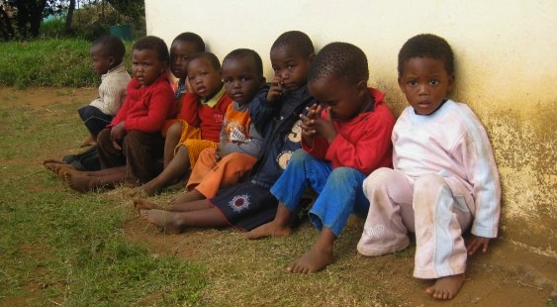
Three years ago, this is who I met and what I saw in South Africa.

Slide 4
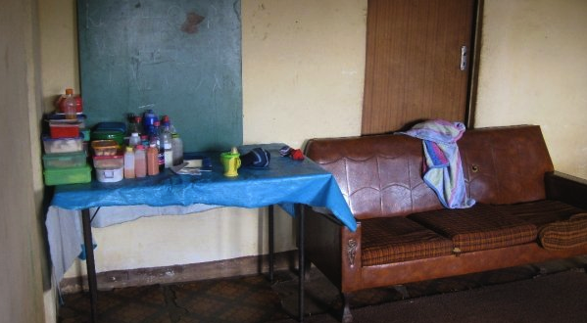

Slide 5
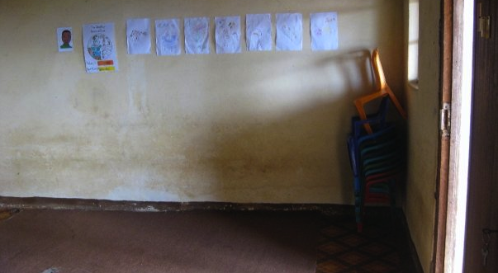

Slide 6
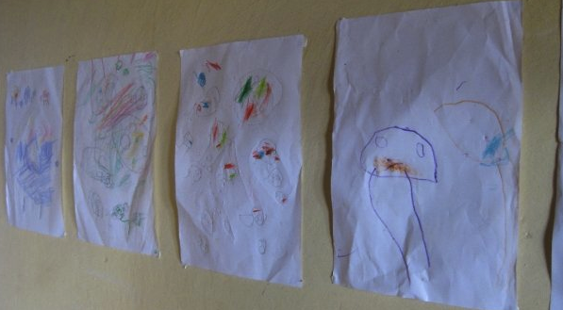

Slide 7
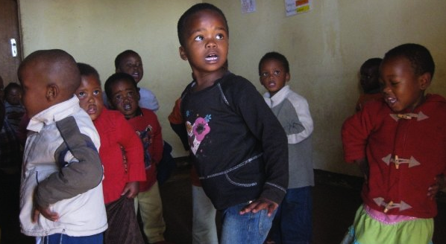

Slide 8
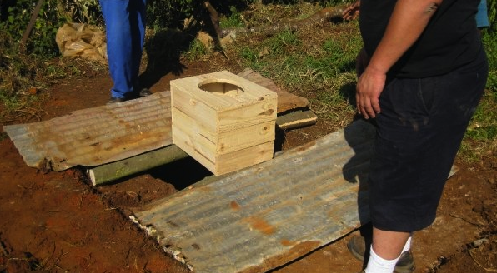

Slide 9
Think about all of the things YOU have that someone else does NOT HAVE.

Slide 10
sleeping on a clean bed instead of a straw mat laid on a dirt floor, many sets of clean clothing instead of one dirty outfit that may not even fit you, walking around in nice shoes instead of walking around barefoot in the dirt, eating at least 2 meals a day with fresh meat and vegetables instead of 2 meals of day with no meat and little vegetables, being in a large classroom with chairs, desks, and lighting instead of tiny room with no desks, dirty floors and no lights, having a roof over your head with doors and windows instead of a mud hut with a thatch roof and no windows, going home to parents and siblings instead of having no mother or father

Slide 11
Be grateful, everyday.

